Slide 1




NEXT GEN EMPLOYABILITY PROGRAM
Creating a futureready workforce
Team Members
College Name
Student Name : S. Vedagiri
Student ID :au513521104054
ANNAI MIRA COLLEGE OF ENGINEERING AND TECHNOLOGY

Slide 2

CAPSTONE PROJECT SHOWCASE
Project Title
Building Bus Reservation System using Python and Django
Abstract | Problem Statement | Project Overview | Proposed Solution | Technology Used | Modelling & Results | Conclusion

Slide 3
Abstract
This project aims to design and develop a Bus Reservation System using the Python programming language and the Django web framework.
The system provides a convenient and efficient platform for users to book bus tickets online, manage reservations, and access relevant travel information.
The key features include user authentication, bus route management, seat selection, booking confirmation, payment processing integration, and administrative functionalities.
Administrators have access to a dashboard where they can manage bus routes, schedules, seat availability, and user reservations. They can also generate reports, monitor transactions, and perform necessary maintenance tasks efficiently.
Source :Intrnet

Slide 4
Problem Statement
Lack of Convenience: Traditional booking methods require customers to visit ticket counters or make phone calls, resulting in inconvenience and time wastage
Limited Access to Information: Customers often lack realtime access to bus schedules, seat availability, and fare details, leading to uncertainty and inconvenience.
Inefficient Reservation Management: Manual reservation systems are prone to errors, leading to overbooking, missed reservations, and administrative challenges for bus operators.
Security Concerns: Existing systems may lack adequate security measures, exposing user data and payment information to potential risks.
Scalability Issues: With the growing demand for online booking services, traditional systems may struggle to accommodate increasing user traffic and transaction volumes.
Source :Internet

Slide 5
Project Overview
The Bus Reservation System project aims to develop a comprehensive webbased platform using Python and Django to facilitate seamless bus ticket booking for users while providing efficient reservation management tools for administrators.
The system will offer a userfriendly interface for customers to browse available routes, select seats, make payments, and receive booking confirmations. Additionally, administrators will have access to a dashboard to manage bus routes, schedules, seat availability, and user reservations.
Source : Internet

Slide 6
Proposed Solution
User Authentication: Secure registration and login.
Route Management: Admin tools to add, edit, and delete routes.
Seat Selection: Realtime seat selection interface.
Booking Process: Seamless process for selecting routes, seats, and making payments.
Payment Integration: Integration with secure payment gateways.
Reservation Management: Tools for admins to manage reservations.
Reporting & Analytics: Generate insights on booking trends.
User Notifications: Automated email/SMS notifications.
Security Measures: Encryption, input validation, access controls.
Scalability: Design for handling increasing traffic and transactions.
Source : Internet

Slide 7
Project Methodology:
Requirements Analysis: Identify and document the functional and nonfunctional requirements of the Bus Reservation System through stakeholder consultations and analysis of existing systems.Design Phase: Design the system architecture, database schema, user interface, and system components using Django's MVC architecture.
Implementation: Develop the system functionalities using Python and Django, including user authentication, route management, seat selection, booking process, payment integration, and administrative tools.
Testing: Conduct thorough testing of the system to ensure functionality, usability, performance, and security, including unit testing, integration testing, and user acceptance testing.
Deployment: Deploy the Bus Reservation System on a web server, ensuring scalability, reliability, and security.
Maintenance and Support: Provide ongoing maintenance and support to address any issues, implement updates, and incorporate user feedback for continuous improvement.

Slide 8

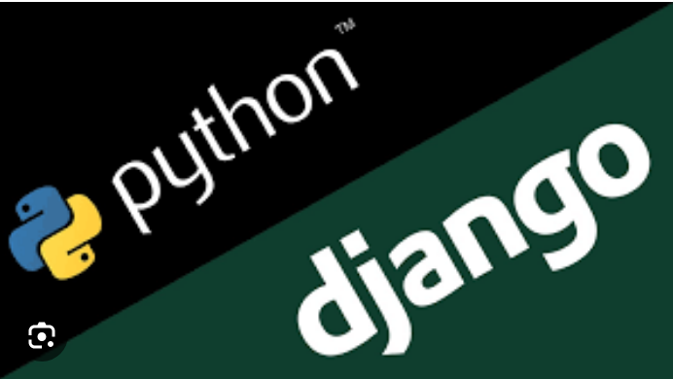
Technology Used
Frontend
Backend
Source : Internet

Slide 9
Modelling & Results
1.Modeling:
Database Schema: Designed database tables to store information such as users, routes, buses, seats, reservations, and transactions.
Django Models: Implemented Django models to represent database tables and define relationships between them.
Views and Forms: Developed views and forms to handle user interactions, such as searching for routes, selecting seats, and making bookings.
Business Logic: Implemented business logic to manage seat availability, handle booking requests, and process payments securely.
Source : Internet

Slide 10
Results:
User Interface: Userfriendly interface for route search, schedule viewing, seat selection, and bookings.
Authentication: Secure user registration, login, and account management.
Route Management: Admin tools for adding, editing, and deleting routes with schedules and fares.
Seat Selection: Realtime seat selection based on availability.
Booking Process: Seamless process for route selection, seat choice, passenger details entry, and secure payments.
Payment Integration: Integration with payment gateways for secure transactions.
Reservation Management: Admin tools for managing reservations, including seat assignments, cancellations, and realtime updates.
Reporting & Analytics: Reporting features for booking trends, revenue, and demographics.
Security Measures: Encryption, input validation, and access controls for data protection.
Scalability: Designed for handling increased traffic and transactions efficiently.

Slide 11
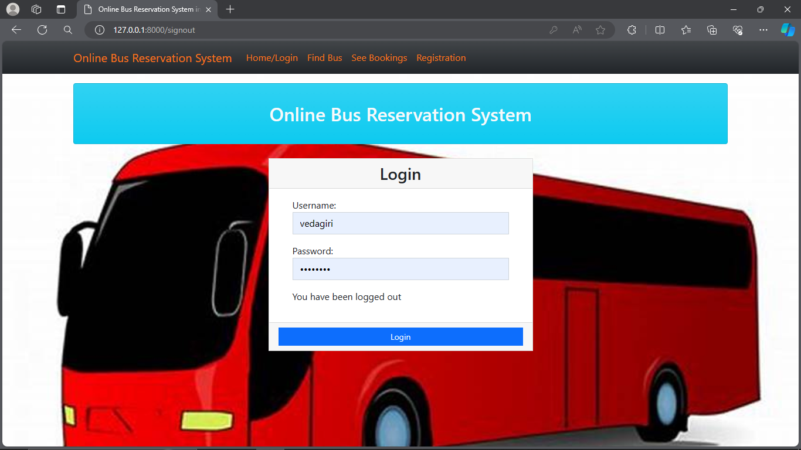
Homepage

Slide 12
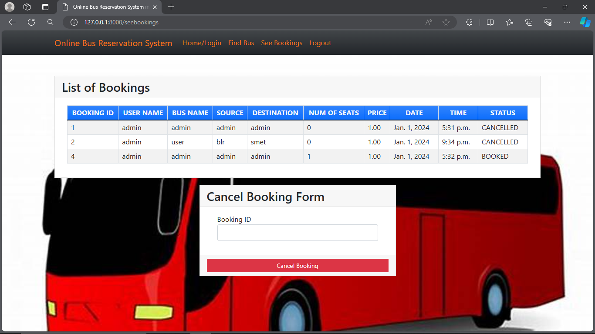
List of Bookings

Slide 13
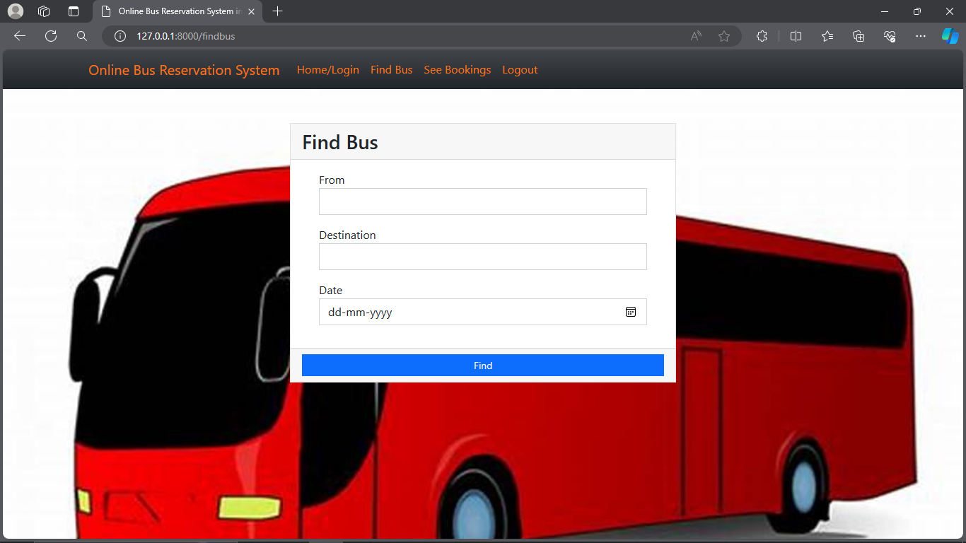
Find Bus

Slide 14
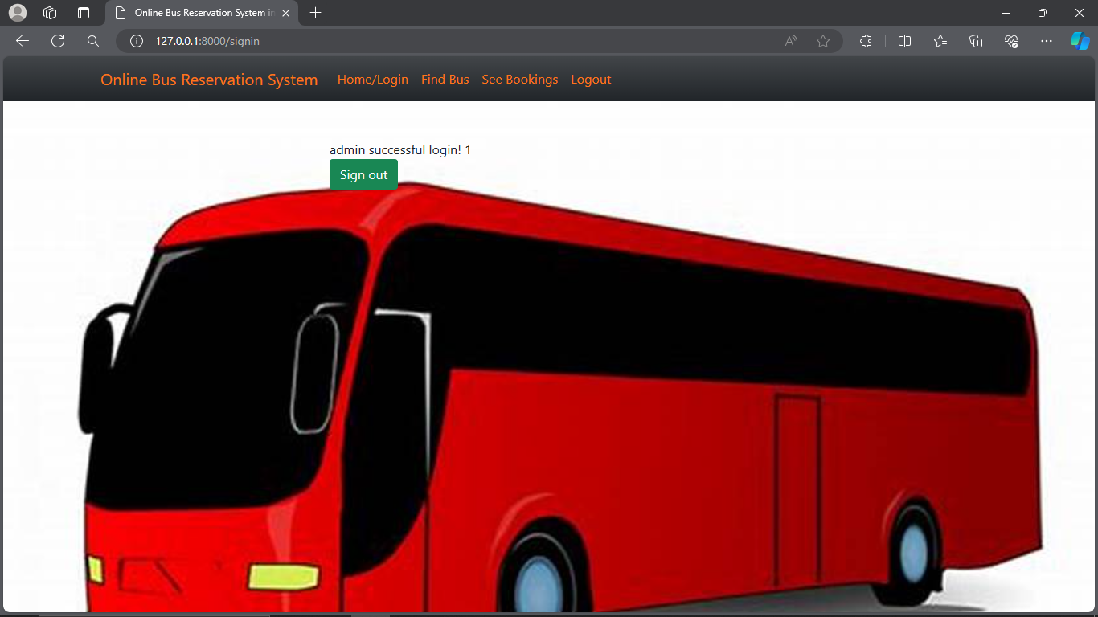

Slide 15
AboutUsPage
Welcome to our Bus Reservation System! We are dedicated to providing you with a convenient and hassle-free platform for booking your bus tickets. Our system is designed with the latest technology to ensure a seamless experience from start to finish.
Login Page:
Welcome back! Please log in to access your account and manage your bookings. If you don't have an account yet, you can easily create one by clicking on the "Sign Up" link below.
[Username/Email] [Password] [Login Button]
Forgot your password? Click here.
Don't have an account? Sign up here.
Our login page is secure, ensuring your personal information remains protected at all times. Thank you for choosing our Bus Reservation System. We look forward to serving you!

Slide 16
Future Enhancements:
Future Enhancements for Bus Reservation System:
Seat Preferences
Route Optimization
Advanced Reporting
Customer Feedback System
Social Media Integration
Accessibility Features
API Integration
Predictive Analytics
Multi-Currency Support
Offline Booking Support

Slide 17
Conclusion
The Bus Reservation System developed with Python and Django provides a seamless booking experience for users while offering efficient management tools for administrators. With features like secure authentication, real-time seat selection, and payment integration, the system enhances convenience and ensures data security.
Future enhancements can include route optimization, predictive analytics, and multi-currency support, ensuring continuous improvement to meet evolving needs.
Overall, the system is a valuable asset for both customers and bus operators, offering convenience, efficiency, and reliability in the booking process.
Source : Internet

Slide 18
Thank You!
Notes:
Thank You !!

